Slide 1

.
Crazy 8
By Chin Michiosy, Masindi nekhubvi, Josh Everest

Slide 2
Overview
Crazy eight (often called the original Uno) is a classic game that involves multiple players and a standard 52-card deck. It is game that was invented in the 1930s for mentally unstable soldiers from the United States Military. In this day and age, it has become an entertaining card game.
The version we made here involves two players each dealt eight cards with a draw pile and a discard pile. The objective of this game, like the famous game Uno is to get rid of all your cards.
Let's show you how it works...

Slide 3
Card movement
Class deck
Shuffle
Const suits, ranks instead of 2 dimensional arrays (populate deck)
Arrange deck
Deal cards
Play card (add card, rem card – why spaces were chosen)
Discard pile (pile) and a draw pile (main) (one increments and one decrements)

Slide 4
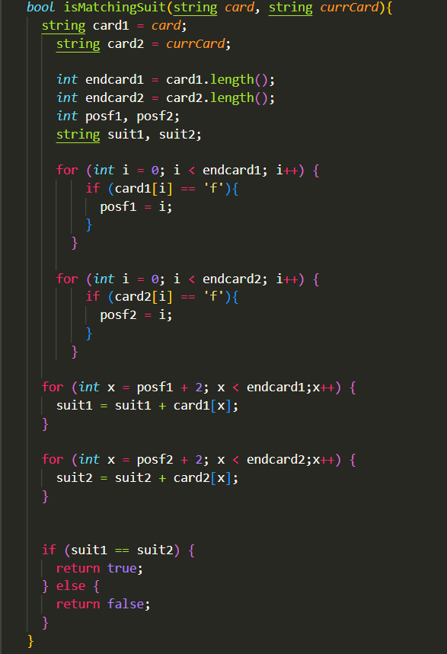
Gameplay
IsMatchingSuit
IsMatchingRank
DrawCard
Specials
Skip
Draw2
eight
SwitchbetweenPlayeers(currCount)

Slide 5
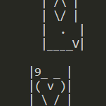

Future work
Things that did not work:
Choosing suit for eight (special function eight)
Card display in terminal (ASCII Art)
Hiding opponent's cards from view
Adding more than 2 players
Tutu error (draw 2)
Playing with the computer (AI –very exciting)

Slide 6
Reflection on lessons learned
C++ is not for this!!!
Better when all group members participate at the same time
The benefits of full functionalization

